Slide 1
The Everyday Forces of Physics
Write short notes on the topic
(a) Gravitational force (Gravity, weight, and the gravitational field)
(b) Gravitational force on a sphere
(c) Gravitational field
(d) Electrostatic force

Slide 2
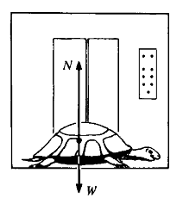
Turtle in an elevator
An amiable turtle of mass M stands in an elevator accelerating at rate a. Find N, the force exerted on him by the floor of the elevator.

Slide 3
The forces acting on the turtle are N and the weight, the true gravitational force W = Mg.
So the weight of turtle = W = N – Ma
( i) When the elevator is at rest or moving with constant velocity. W = N
Thus apparent weight = actual weight. The weighing machine shows exact weight.
(ii) When the elevator is accelerating upwards If an elevator is moving with upward acceleration +a

Slide 4
(iii) When. the elevator is accelerating downwards If the elevator is moving down with an acceleration -a,
N = Mg – Ma = M (g - a)
Apparent weight of t he person is lesser than his actual weight.
If the downward acceleration equals g, i.e a = g
N = 0 and the turtle "floats" in the elevator. The turtle is then said to be in a state of weightlessness.

Slide 5
Contact Forces
Contact forces are produced by atomic or molecular interactions at short distances. Examples are the static and sliding friction, force of viscosity, the pulling of a string etc.
Tension: When an inextensible string is pulled on both ends, the string stretches and a resistive force is developed on the string, which is known as tension. If the string does not breaks , the applied force is balanced by tension in the string.

Slide 7
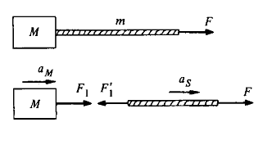
Block and string
Consider a block of mass M in free space pulled by a string of mass m. A force F is applied to the string, as shown. What is the force that the string "transmits" to the block?

Slide 8
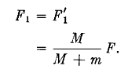
F₁ is the force of the string on the block, F’₁ is the force of the block on the string, a_{m} is the acceleration of the block, and a_{s} is the acceleration of the string.
The equations of motion are
Assuming that the string is inextensible, it accelerates at the same rate as the block, giving the constraint equation a_{s} = a_{m}
F₁ = F’₁ by Newton's third law. Solving for the acceleration, we find that

Slide 9
The force on the block is less than F; the string does not transmit the full applied force. However, if the mass of the string is negligible compared with the block, F₁ = F’₁ to good approximation.

